Slide 1
Atlantic Coastal Fish Habitat Partnership
Making the Connection
Robert Atwood
NH Fish & Game Department
Robert.Atwood@wildlife.nh.gov

Slide 2
Outline
1
2
3
4
5
Introduction
Priority Habitats
Challenges & Threats
Conservation Strategies
Regional Impacts

Slide 3
Introduction
Our Vision
“To accelerate the conservation, protection, restoration, and enhancement of habitat for native Atlantic coastal, estuarine-dependent, and diadromous fishes through partnerships between federal, tribal, state, local and other entities”
Our Mission
“Healthy, thriving habitats of sufficient quantity and quality to support all life stages of Atlantic coastal, estuarine-dependent, and diadromous fishes”
The Atlantic Coastal Fish Habitat Partnership (ACFHP) is a coast-wide assembly of 39 different state, federal, tribal, and non-governmental organizations committed to protecting, preserving, and enhancing Atlantic fish habitats.
Notes:
It was formed in 2006 under the National Fish Habitat Action Plan and operates within the framework of the National Fish Habitat Partnership (NFHAP). Our focus is on the conservation of habitats for diadromous, estuarine-dependent, and coastal fish species. Through collaboration and coordination, we aim to identify the causes of habitat declines, implement strategic corrective action, and measure and communicate progress made through our efforts.

Slide 4
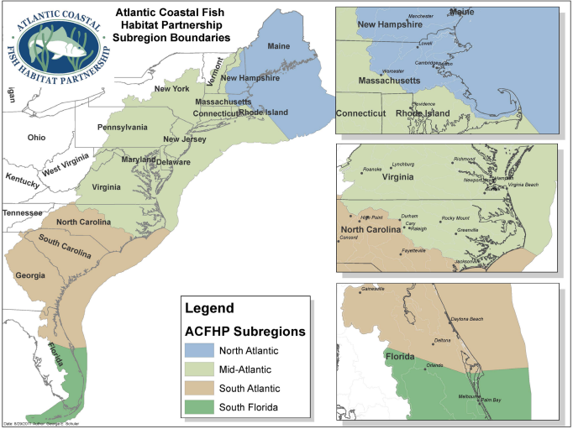
Geographic Scope:
ACFHP extends from the Florida Keys to Maine and is broken up into 4 sub-regions:
North Atlantic
Mid-Atlantic
South Atlantic
South Florida
~29,000 miles of shoreline and coastal waters
Includes a densely populated area with over 25% of the U.S. population
Notes:
ACFHP is designed to bring diverse groups together across the east coast (i.e.,) Resource Managers, Scientists, and Communications Professionals.
Its extensive region includes the some of the most densely populated cities and major estuaries like the Chesapeake Bay and the New York Harbor.

Slide 5
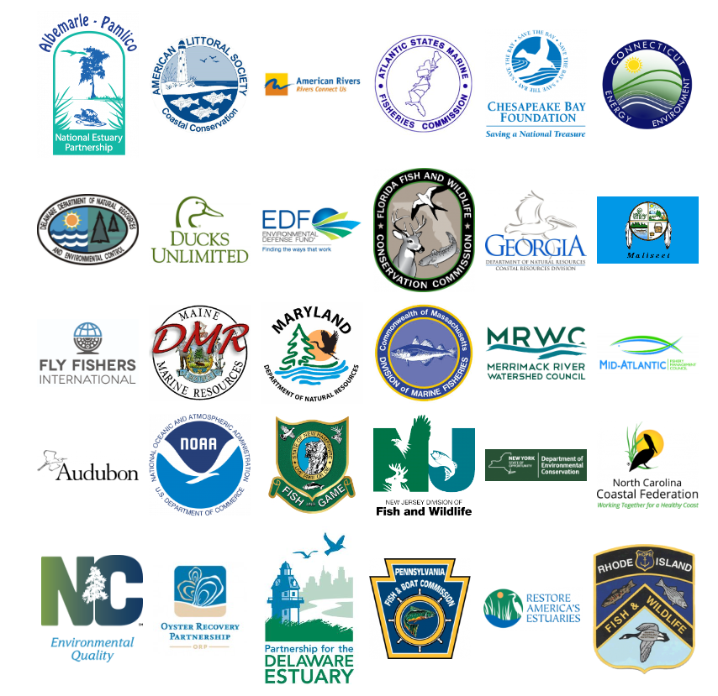
39 Partners:
Mid-Atlantic Fishery Management Council
RI Dept. of Environmental Management
New England Fishery Management Council
NH Fish and Game
Fly Fishers International
Houlton Band of Maliseet Indians
Ducks Unlimited
The Nature Conservancy

Slide 6
Financial & Administrative support provided by
Atlantic States Marine Fisheries Commission
Arlington, VA
U.S. Fish and Wildlife Service
Regional Office
National Fish Habitat Partnership
Summer 2023 Steering Committee Meeting:
John Heinz National Wildlife Refuge, Philadelphia, PA
Notes:
Steering committee is composed of members from agencies & organizations including New Hampshire Fish & Game, American Rivers, Rhode Island DEM, Mass. DMF, New York State DEC, New Jersey DEP, The Nature Conservancy, Mid-Atlantic FMC (chair), Chesapeake Bay Foundation (vice chair)… etc.

Slide 7
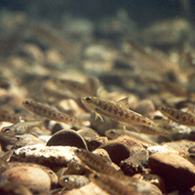
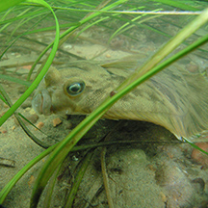
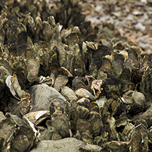
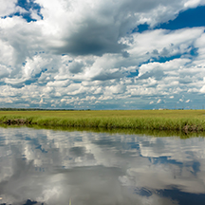
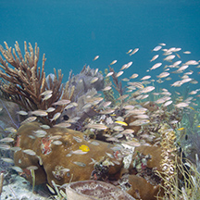
Priority Habitats
Riverine Bottom
Submerged Aquatic Vegetation
Marine & Estuarine Shellfish Beds
Tidal Vegetation
Coral and Live/Hard Bottom
Mid- and North Atlantic
Notes:
Tidal Vegetation is not considered a priority habitat in the North Atlantic sub-region

Slide 8
Notes:
Examples: Dams; hydropower facilities; hurricane and storm barriers; road crossings and culverts;

Slide 9
Notes:
Examples: Recreational and commercial vessels; prop scarring; anchoring; grounding; and discharge

Slide 10
Notes:
Examples: Surface water and groundwater quality/quantity; point/non-point source pollution; nutrient loading; atmospheric deposition; and dissolved oxygen concerns

Slide 11
Notes:
Examples: Dredging; blasting; port expansion and maintenance; dredge spoil disposal; and beach maintenance (including beach fill, mining of sand, bulldozing, sand bypass, sand bags, and shoreline stabilization)

Slide 12
Priority Habitats (Mid & North Atlantic)
Riverine Bottom
Submerged Aquatic Vegetation
Marine & Estuarine Shellfish Beds
Tidal Vegetation
Notes:
These are the 4 Priority Habitats in the Mid- and North Atlantic subregions

Slide 13
Conservation Strategies
Building Local and Regional Relationships
Coordinating Outreach Initiatives
Developing Science & Data Products
Funding On-the-Ground Habitat Restoration Projects
Notes:
Building relationships w partners: Collaborating with stakeholders, government agencies, NGOs, and local communities to implement conservation initiatives and address habitat threats collectively.
Outreach: Engaging in conferences, workshops, and outreach events to raise awareness about fish habitats and foster public involvement in conservation efforts.
S&D: Conducting research, collecting data, and developing tools to better understand fish habitats and inform conservation decisions.
Supporting restoration efforts such as dam removals, oyster reef and living shoreline projects construction, and improving water quality to promote healthy fish habitats.

Slide 14
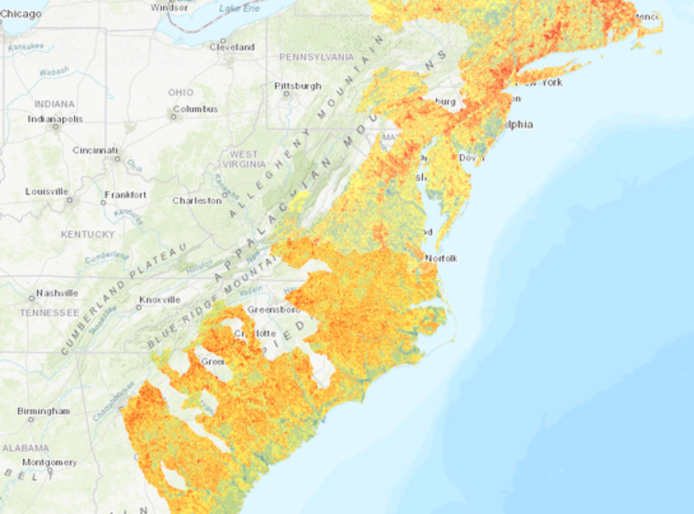
Science & Data
Fish Habitat Conservation Area Mapping and Prioritization Project (2020)
Notes:
Used in evaluation criteria when soliciting projects

Slide 15
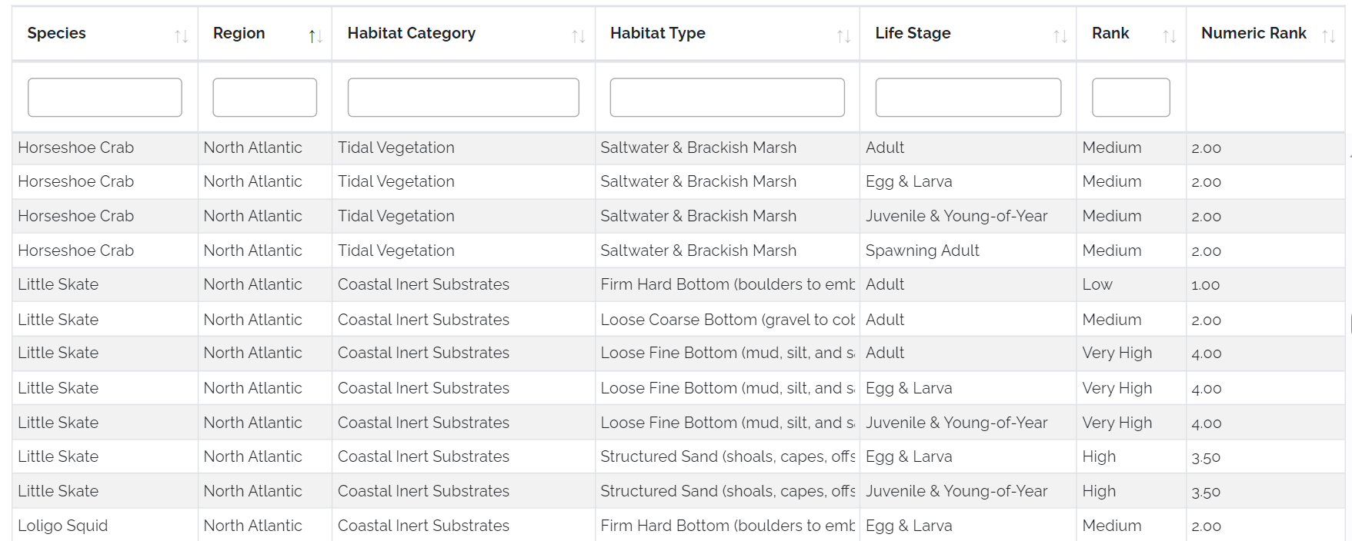
Science & Data
Species-Habitat Matrix

Slide 16
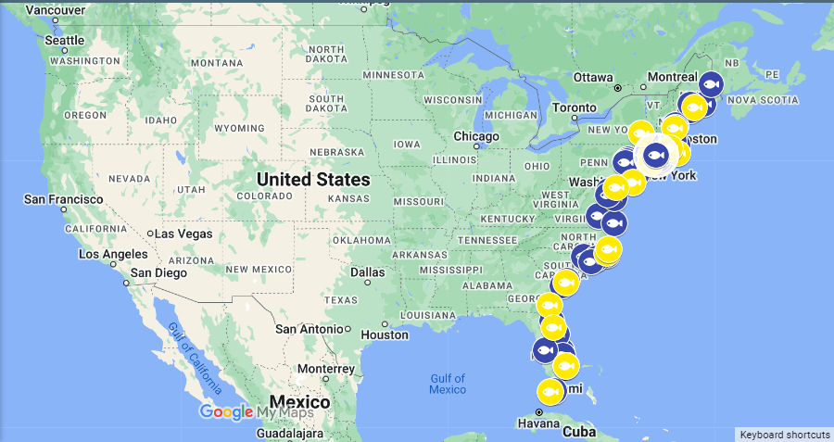
Project Endorsements
Notes:
In addition to funding on-the-ground restoration projects

Slide 17
Melissa Laser Fish Habitat Conservation Award
Annual award celebrating outstanding fish habitat conservation efforts along the Atlantic coast
Honors the legacy of one of the founding ACFHP Steering Committee members, Dr. Melissa Laser of the Maine Department of Marine Resources.
Engages a wider community of resource managers, volunteers, and scientists beyond ACFHP.
Scott Cuppett, New York State Dept. of Environmental Conservation (NYSDEC)
Notes:
Scott Cuppett: Program Manager at the NYSDEC’s Hudson River Estuary Program and Cornell University’s Water Resources Institute was honored in October 2024 for his visionary leadership in conserving Atlantic coastal and estuarine habitats, pioneering New York’s “Trees for Tribs” program, co-founding the Hudson River Watershed Alliance, and advancing fish passage restoration through dam removals and culvert enhancements.

Slide 18
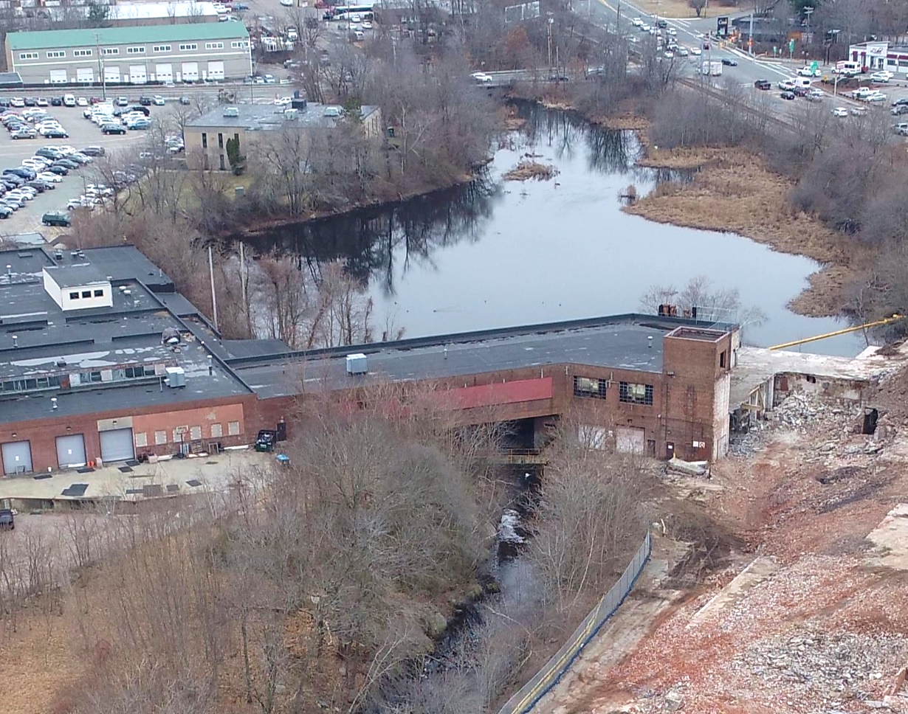
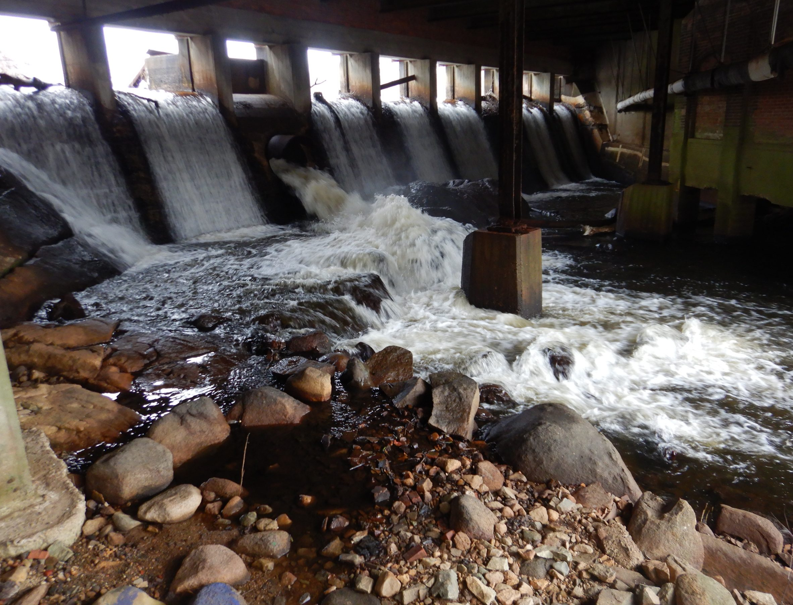
Regional Impact: Northeast
Armstrong Dam Removal
Monatiquot River, MA
Led by Town of Braintree
Restored 36 miles of unimpeded upstream access to 180 acres of river herring spawning habitat
Completed Oct. 2023
Notes:
Additional ACFHP-funded project led by Town of Braintree, MA: Ames Pond Dam Removal & Rock Falls Fishway
Completed: May 2024

Slide 19
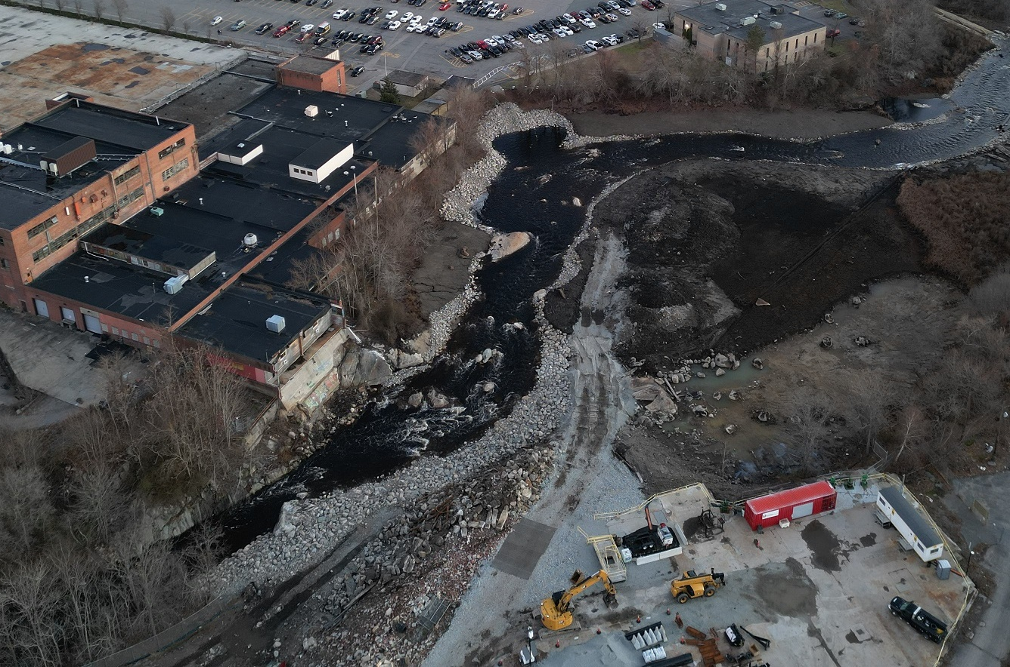
Regional Impact: Northeast
Armstrong Dam Removal
Monatiquot River, MA
Led by Town of Braintree
Restored 36 miles of unimpeded upstream access to 180 acres of river herring spawning habitat
Completed Oct. 2023
Notes:
Additional ACFHP-funded project led by Town of Braintree, MA: Ames Pond Dam Removal & Rock Falls Fishway
Completed: May 2024

Slide 20
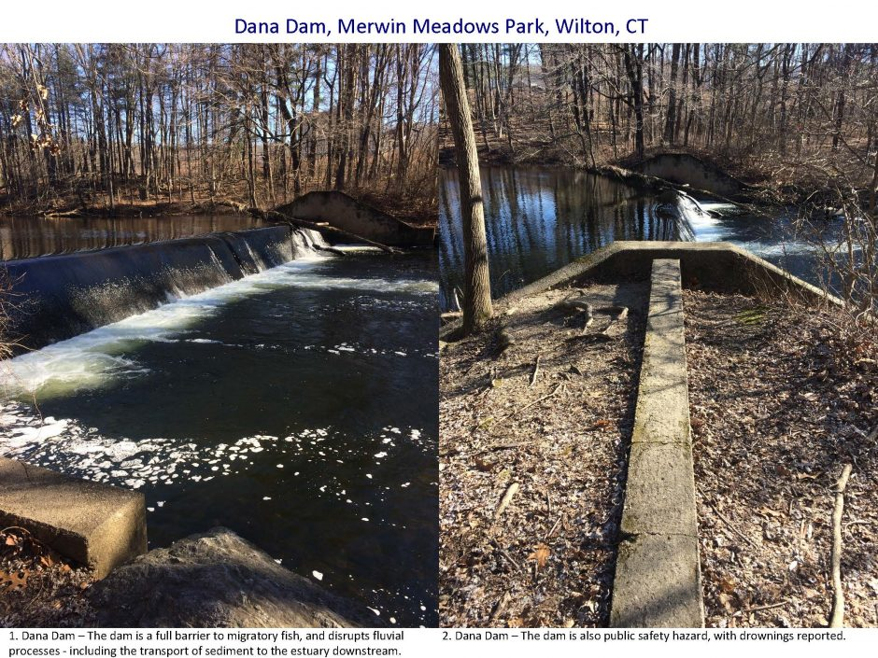
Regional Impact: Northeast
Dana Dam Removal on the Norwalk River Watershed
Norwalk River, CT
Led by Save the Sound
Reconnected 6.5 upstream river miles, Restored 17 mile stretch of the Norwalk River to Long Island Sound.
Completed Dec. 2023

Slide 21
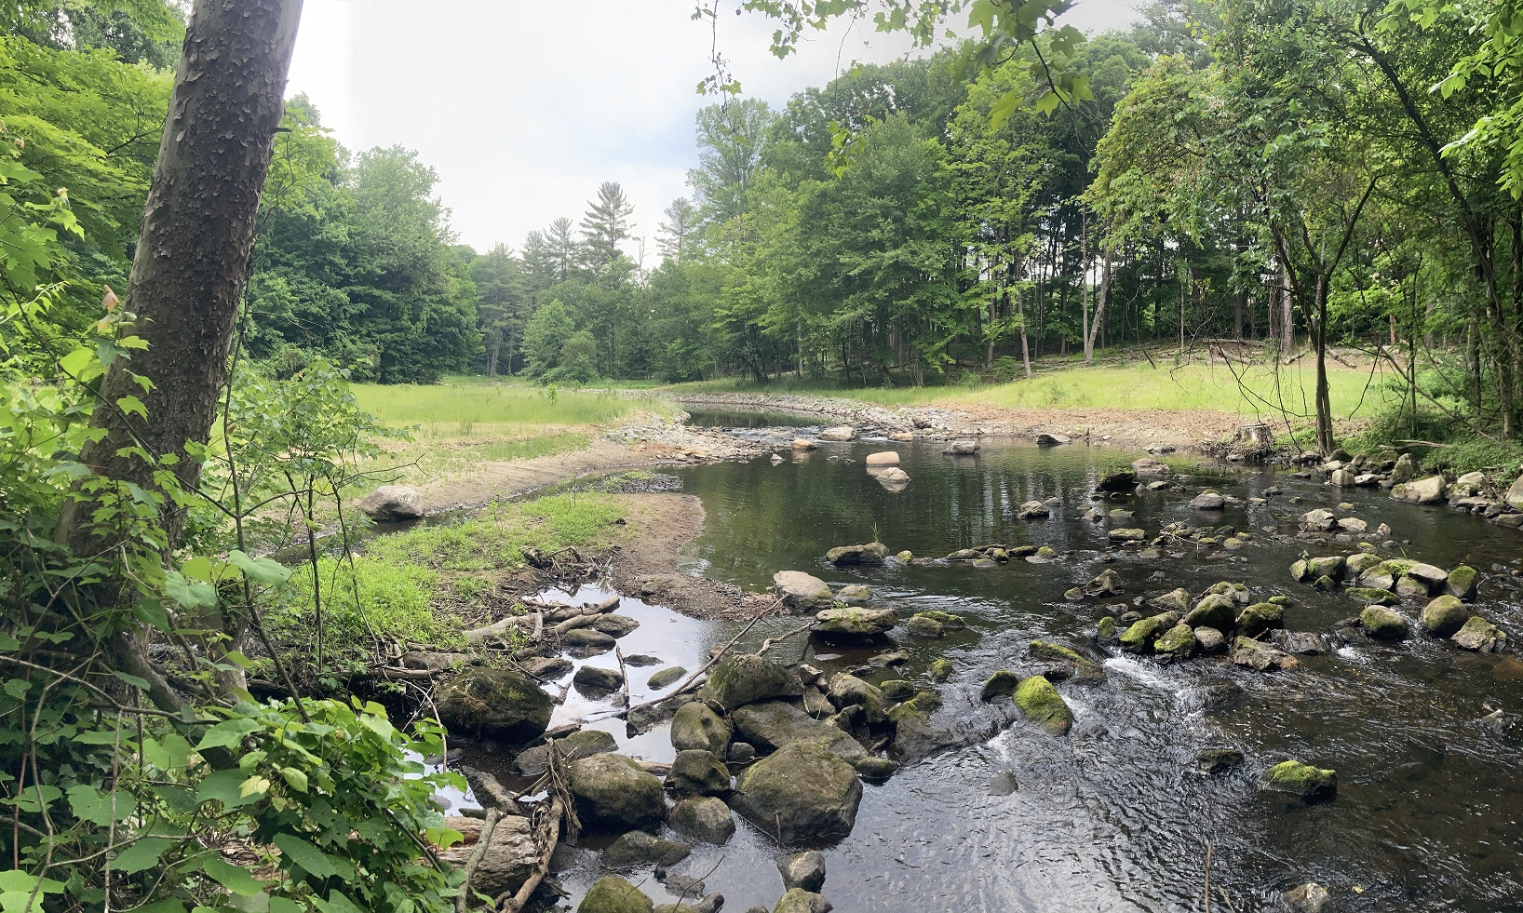
Regional Impact: Northeast
Dana Dam Removal on the Norwalk River Watershed
Norwalk River, CT
Led by Save the Sound
Reconnected 6.5 upstream river miles, Restored 17 mile stretch of the Norwalk River to Long Island Sound.
Completed Dec. 2023

Slide 22
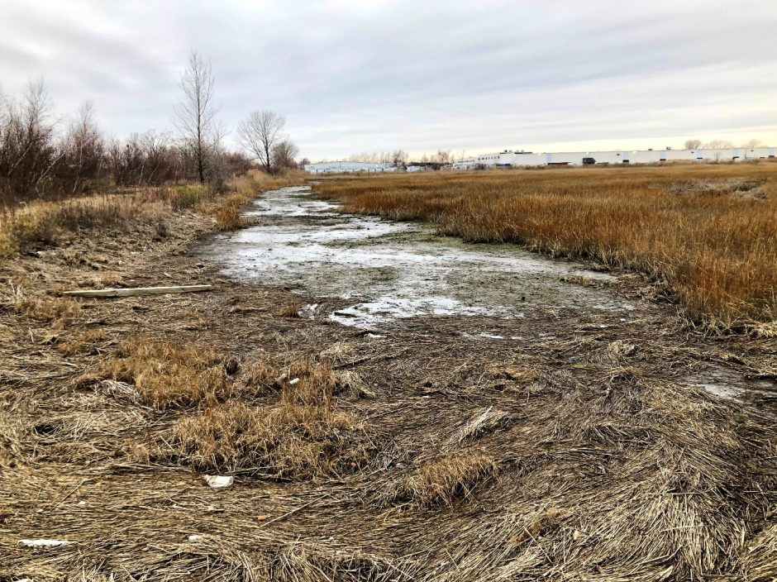
Regional Impact: Northeast
Great Meadows Salt Marsh Restoration
Stratford, CT
Led by Audubon Connecticut
Restored 39 acres of coastal salt marsh and other intertidal habitats. 155,000+ native plants planted.
Completed Aug. 2022
Audubon Connecticut

Slide 23
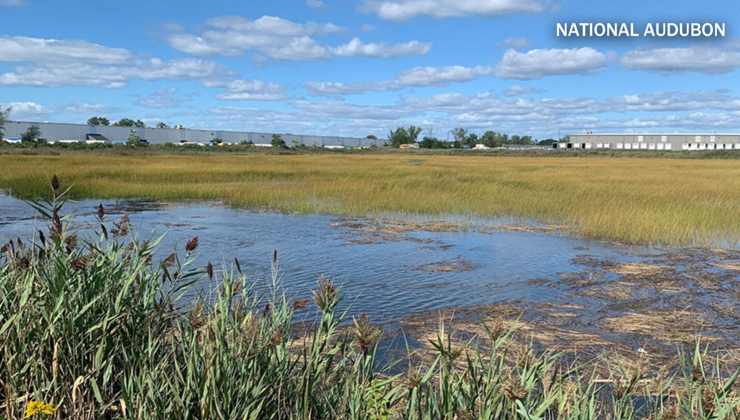
Regional Impact: Northeast
Great Meadows Salt Marsh Restoration
Stratford, CT
Led by Audubon Connecticut
Restored 39 acres of coastal salt marsh and other intertidal habitats. 155,000+ native plants planted.
Completed Aug. 2022

Slide 24
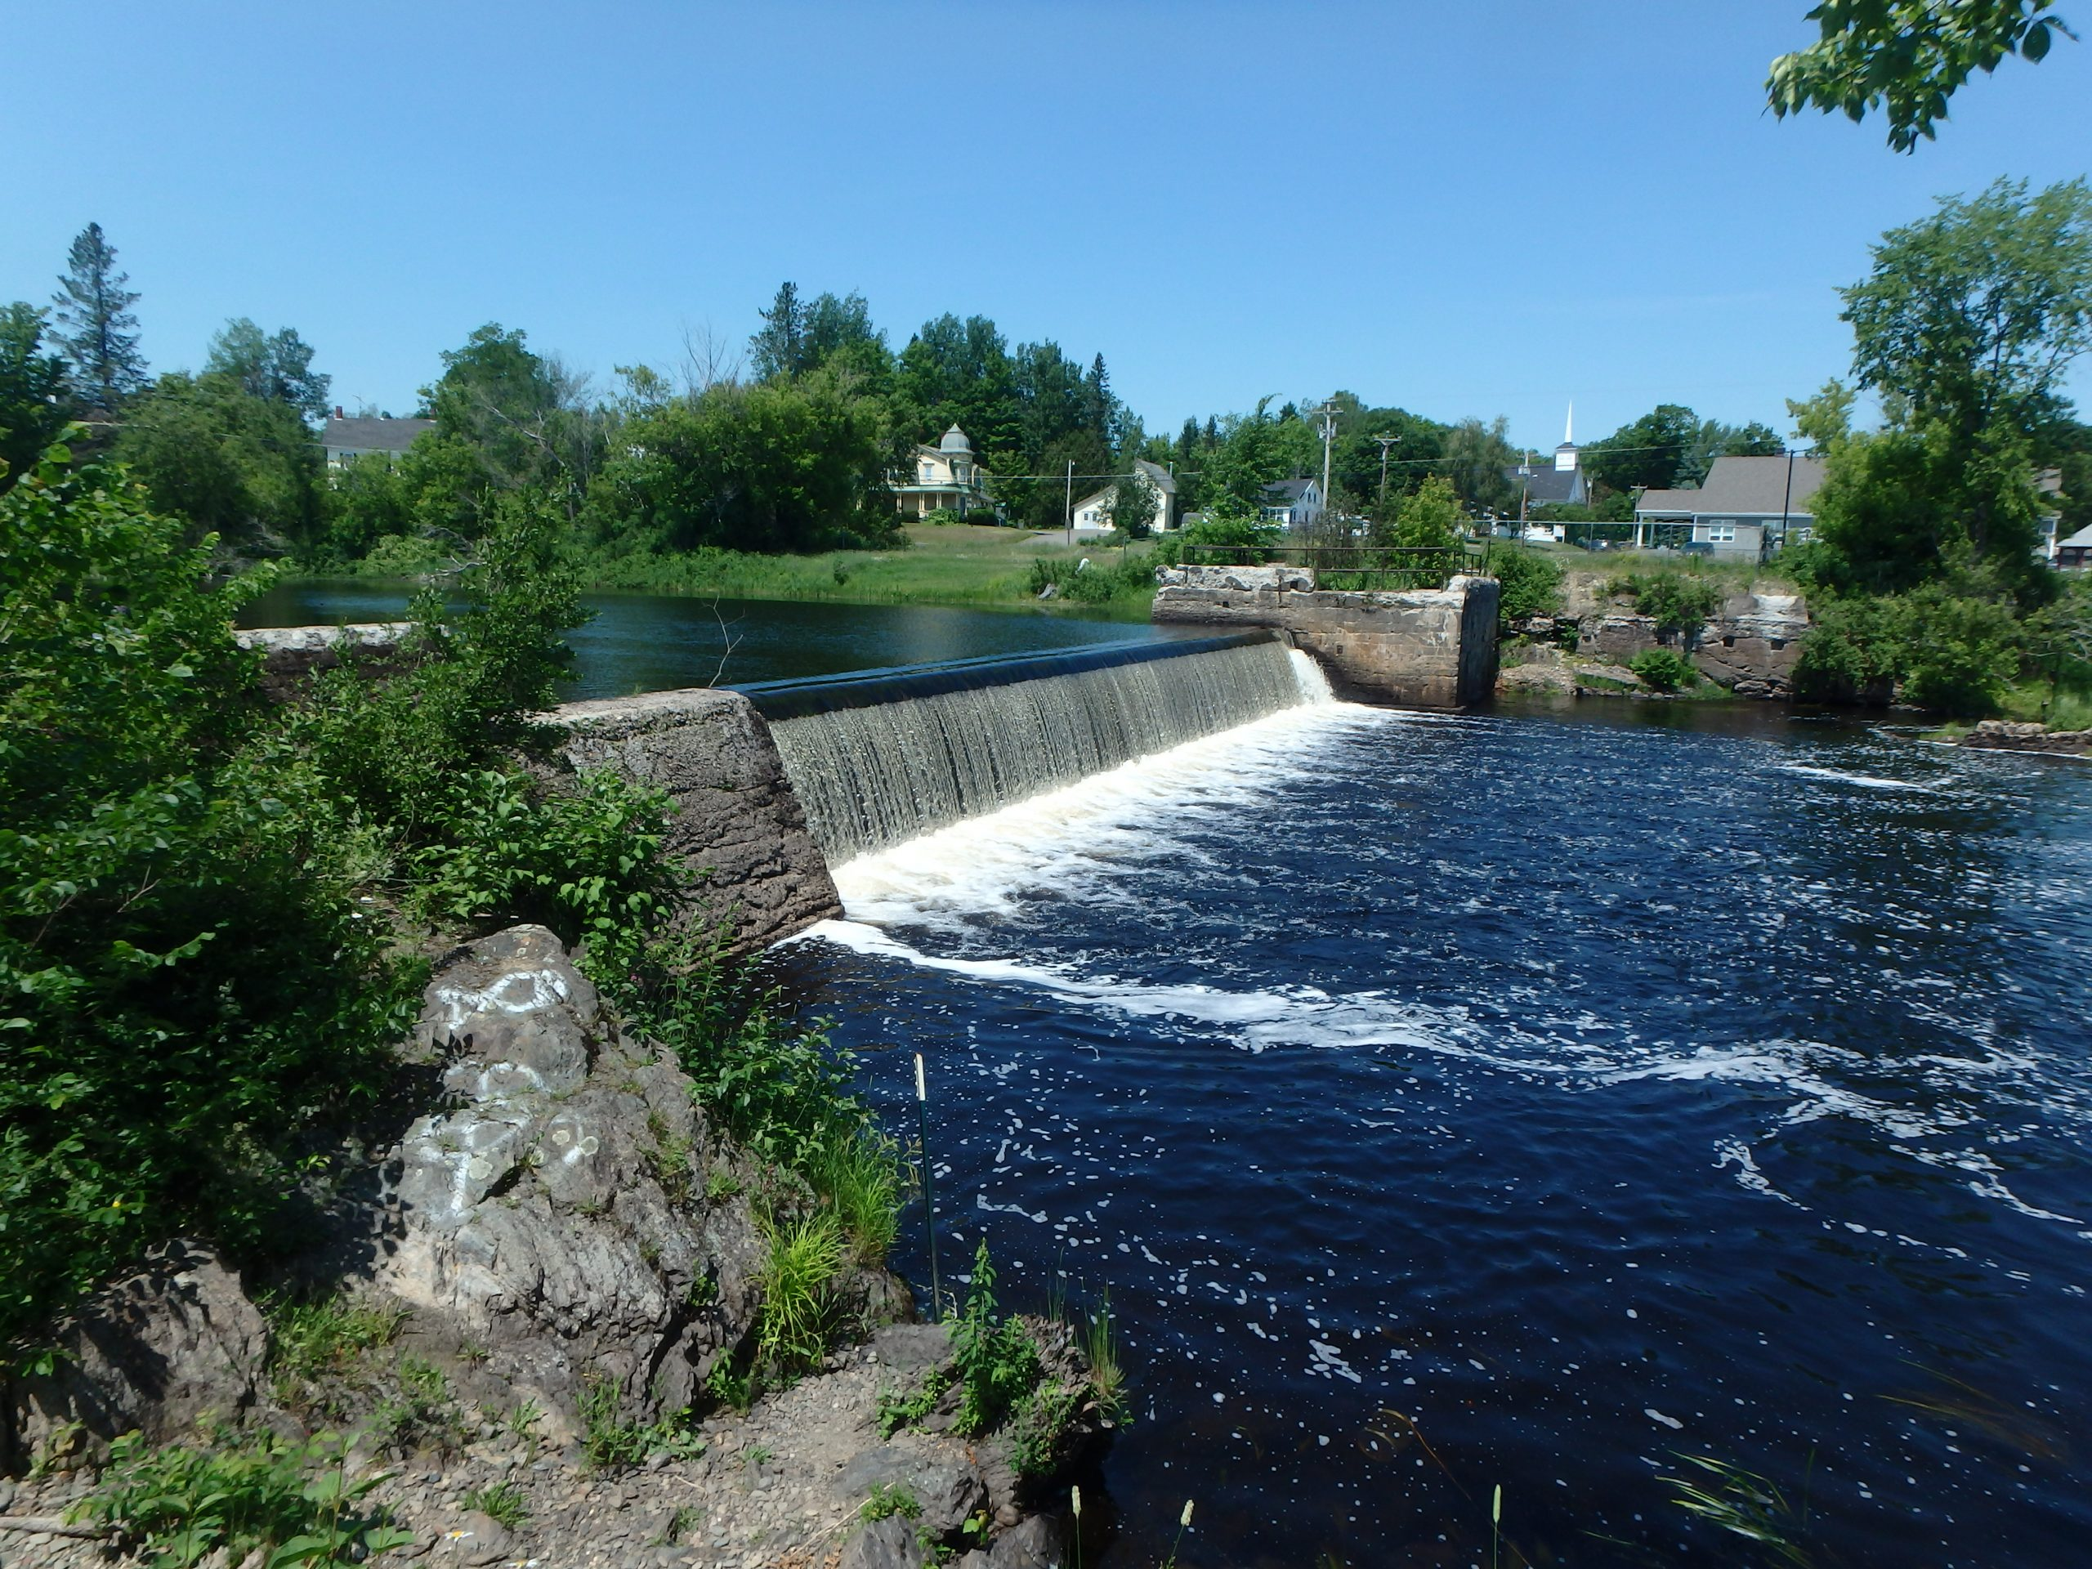
Regional Impact: Northeast
Baskahegan Lake and Crooked Brook Flowage Fish Passage
Danforth, ME
Led by Atlantic Salmon Federation
Restored access to 8,960 acres and 137 miles of stream habitat for alewives and other diadromous fish species.
Completed Sep. 2024
Notes:
The project involved building a pool and weir fishway.

Slide 25
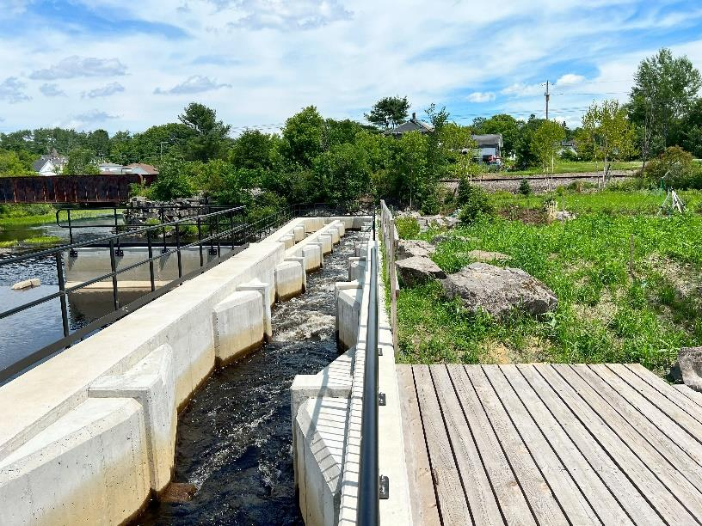
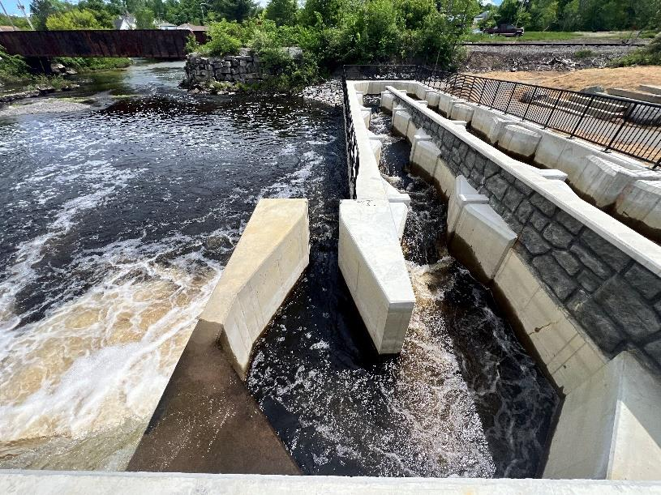
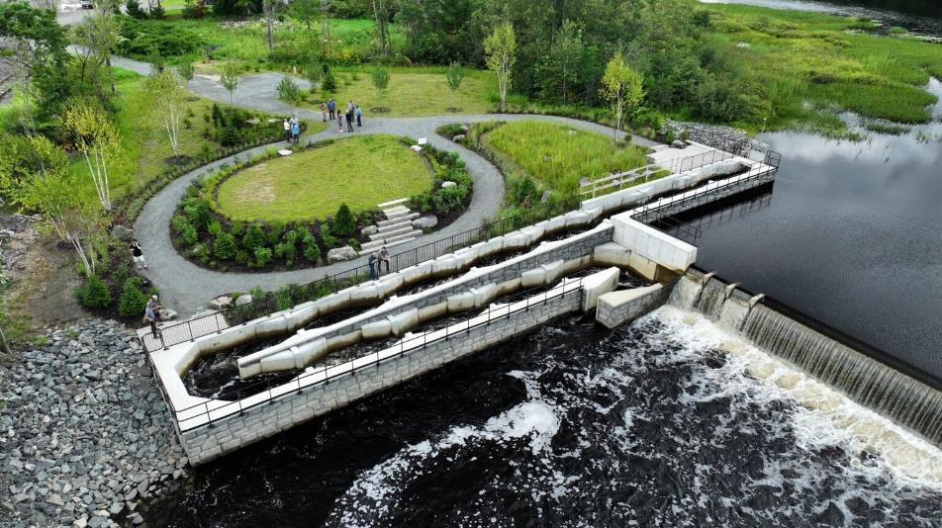
Regional Impact: Northeast
Baskahegan Lake and Crooked Brook Flowage Fish Passage
Danforth, ME
Led by Atlantic Salmon Federation
Restored access to 8,960 acres and 137 miles of stream habitat for alewives and other diadromous fish species.
Completed Sep. 2024
Notes:
The project involved building a pool and weir fishway.

Slide 26
Summary
On-the-Ground Restoration
Outreach & Engagement
Conservation Excellence Award
Science & Data
Project
Endorsement
Notes:
Future goals and strategies:
Continue to align goals with partners and adapt to emerging challenges like climate change.
Expand focus on under-resourced communities.

Slide 27
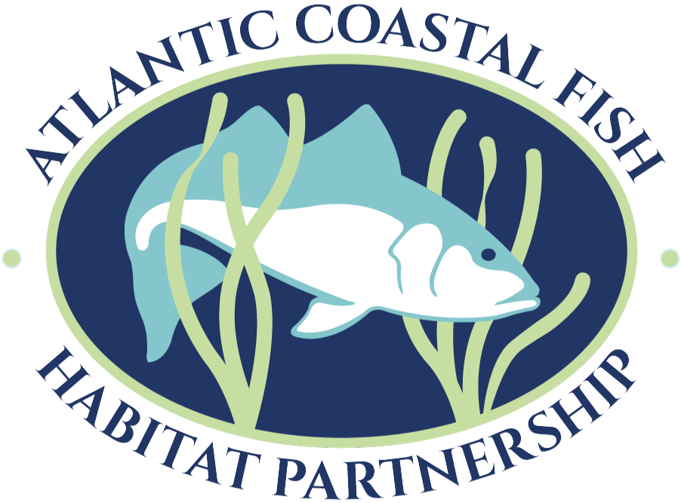
MAKING THE CONNECTION ATLANTICFISHHABITAT.ORG
From the headwaters to the continental shelf
Among state, federal, tribal, and non-governmental organizations
Between people and fish habitat

Slide 28
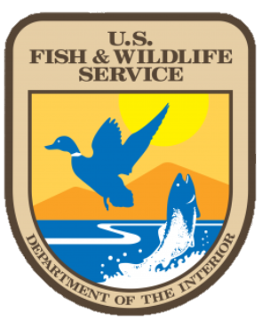
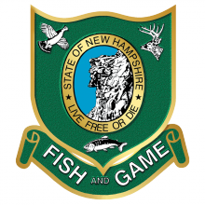
Acknowledgements
AND ALL OF
OUR PARTNERS!

Slide 29
THANK YOU!
Robert Atwood
New Hampshire Fish & Game Department
Robert.Atwood@wildlife.nh.gov

